Slide 1



Choosing Food for Health
Michelle (Metallo) Fournier RN, CDCES United Healthcare Health Engagement Nurse for Kenosha Unified School District

Slide 2




Food,
Glorious Food!
© 2022 United HealthCare Services, Inc. All Rights Reserved.
Notes:
Food is a necessary and enjoyable part of our lives. It plays a major role in daily living as well as holidays, celebrations and gatherings. We pass down family recipes and traditional cuisine, and discover new food through our friends, partner and their family, restaurants, and through travel.

Slide 3
Habit
Health
Budget
Convenience
Why
do we eat
what we eat?
Social
Taste
Culture
Manage illness
Notes:
Think about why you eat what you eat. Is it because of convenience? Habit? Taste? Budget?
These are all legitimate and important reasons. But what if we consider what our body needs to function correctly and what it requires to perform at its highest potential.
What we choose to eat is an opportunity to shape your health, Every food choice send a message to your body that affects all bodily functions: your energy level, your brain and organ function and more.
In this presentation, we will discuss the way food effects your body.

Slide 4
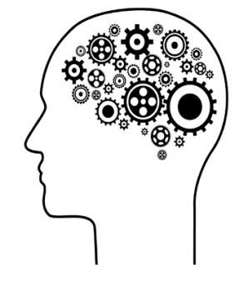

What Does The Body Need:
To survive
To function efficiently
To thrive
Notes:
(First read slide. )
Our caveman ancestors ate whatever they could to survive.
We then discovered that diet influences how well the body functions.
Today, we know that our diet can help our body reach its highest potential, OR
it can interfere with bodily functions, damage cells, and create an environment that fosters disease development.
Let’s compare it to making cookies. Baking requires the right ingredients, each in the precise amount, baked on the right temperature, for the correct amount of time. When this is done, the cookies function efficiently.
What happens if you mistakenly substitute salt for sugar, or you add 1c of baking soda and a ½ tsp of flour, or you bake them for 2 hours at 500 degrees?… yikes!
These cookies are not so tasty – and don’t even make it into the first category –To survive!
For a cookie to Thrive, you must follow the best recipe. Use the highest quality and freshest ingredients. Mix the dry and the wet
ingredients separately. Preheat the oven and bake them using premium cookie sheets.
Not everyone will make cookies that thrive, but you at least want them to survive. Now let's relate this to meal planning.

Slide 5

Food Categories
Macronutrients:
Carbohydrates, Proteins & Fats - Main components of food
Micronutrients:
Vitamins -A, B series, D and Minerals -Calcium, Potassium Sodium, Iron, Zinc
Phytonutrients:
Reduce, Slow, and Prevent cellular damage, Repair DNA, Decrease inflammation, Lower the risk of cancer and chronic disease, Improve Cognition, Immunity, and Cardiovascular health
Flavonoids, Carotenoids, Resveratrol
Fruits, vegetables, nuts, grains, tea
Antioxidants:
A class of phytonutrients and provide the same benefits
Berries, Dark Chocolate, Leafy Greens, Nuts, Legumes, Beans, Turmeric, Cinnamon, Oregano, Tea
Fiber:
Support digestive health, Feed the healthy gut microbes (probiotics), Lower cholesterol, Stabilize blood sugar, Aid in weight management
Whole Grains, Fruit, Vegetables, Beans, Legumes, Nuts, Seeds
Notes:
Food falls into different categories
Phytonutrients are the protectors of plants and some of the protective qualities carry over to us when we eat them.

Slide 6


Macronutrients
Carb
The
Building
Blocks
of Nutrition
Protein
Fat

Slide 7
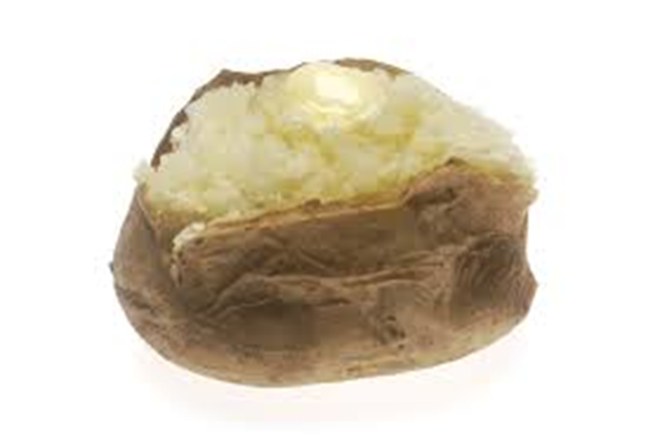
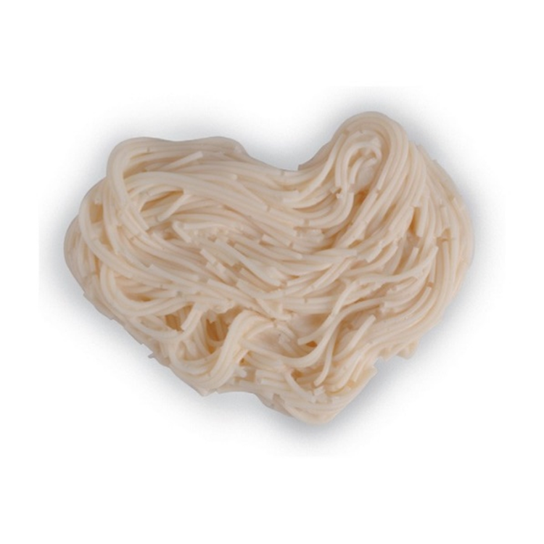




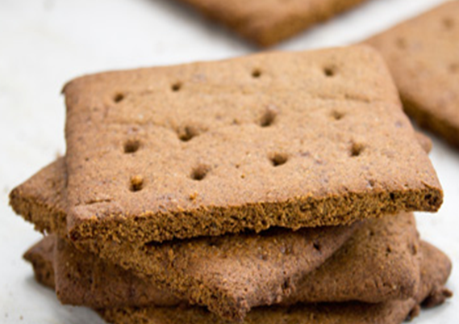

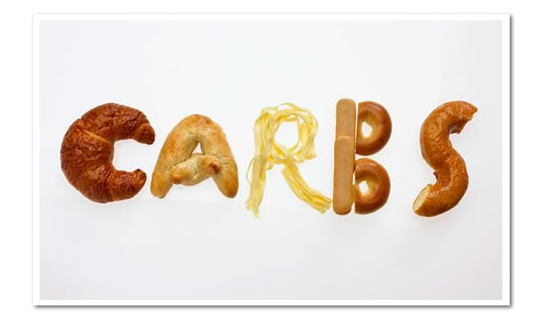
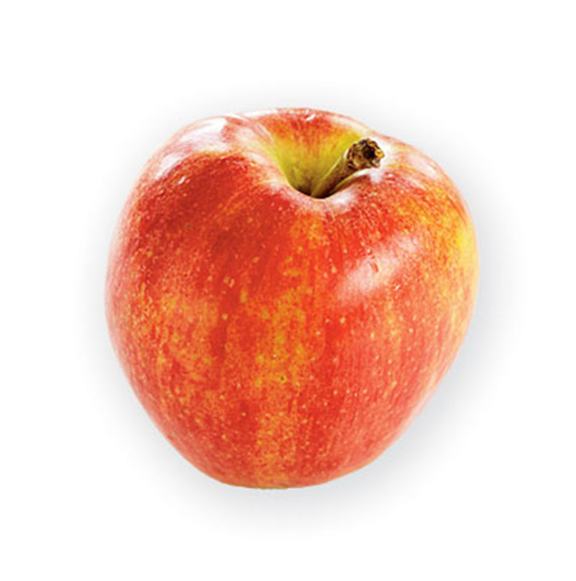
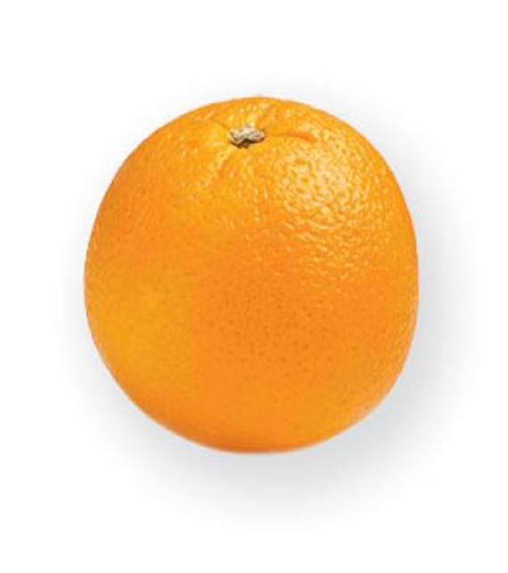
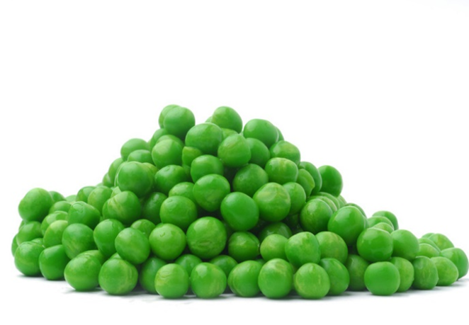
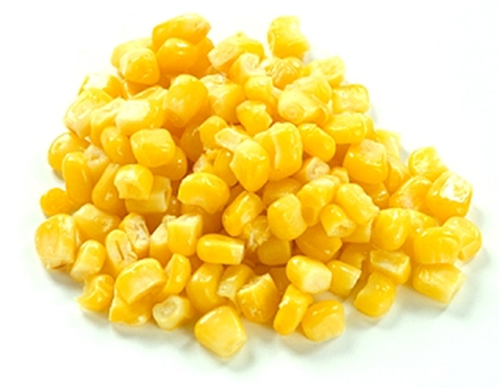


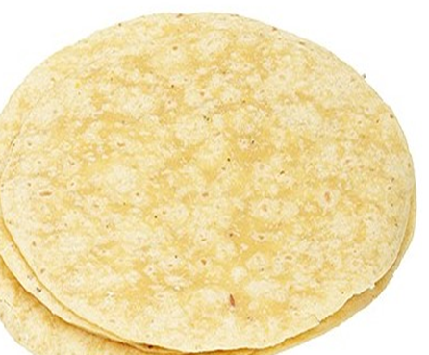
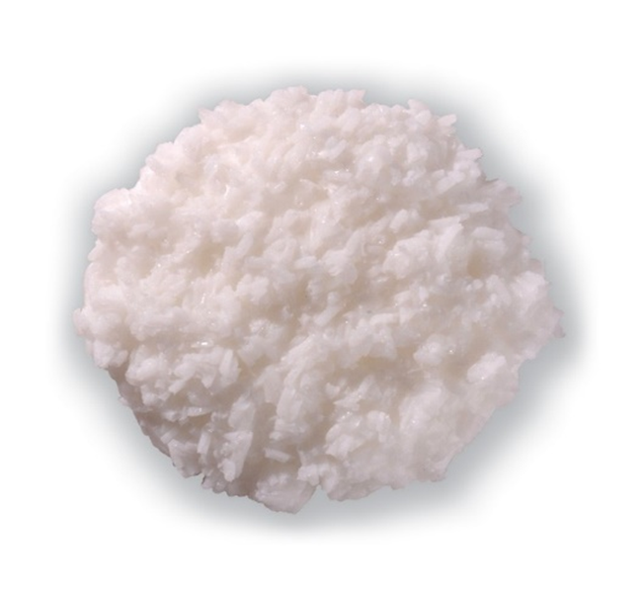
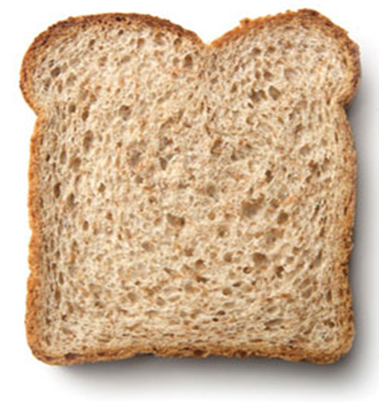
Notes:
Carbohydrates are the grains, rice, oat, wheat, and everything made with wheat flour, such as bread, tortillas, pancakes, pasta, baked goods, crackers, cookies. Starchy vegetables like potatoes, corn, peas, all fruit, Honey, syrup, sugar and anything made with them like candy, jelly, regular soda and other sweet drinks
Carbs get a bad rap, because they turn into glucose, aka sugar. Wait, Isn’t sugar unhealthy?
Let me explain this a bit, eating plain old sugar is different than our body turning carbs into sugar, aka glucose. This is our body and brain’s most efficient fuel source. It gives the energy we need to function. Our brain alone, requires about 100-150 grams of glucose per day to function at its optimal level. The brain is not meant to use other nutrients for its energy and doesn’t do so efficiently.
Since I am a certified diabetes educator, I need to mention that it can be especially dangerous for people with DM to avoid carbs, especially those with type 1 diabetes. I’ll discuss the keto diet and more in an upcoming presentation.

Slide 8
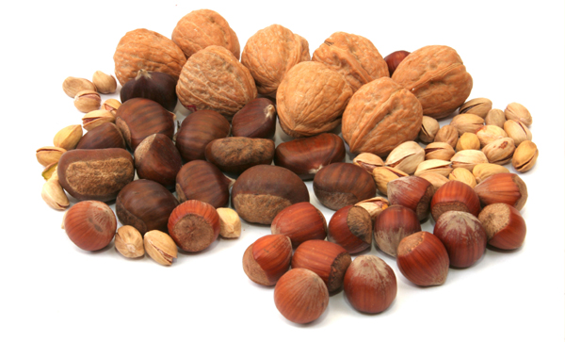
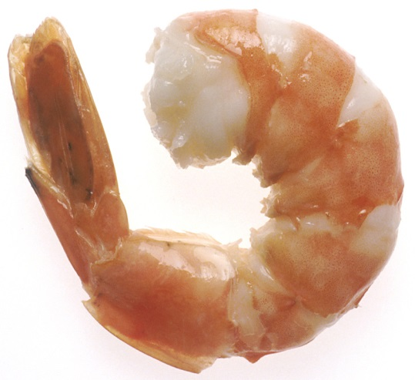
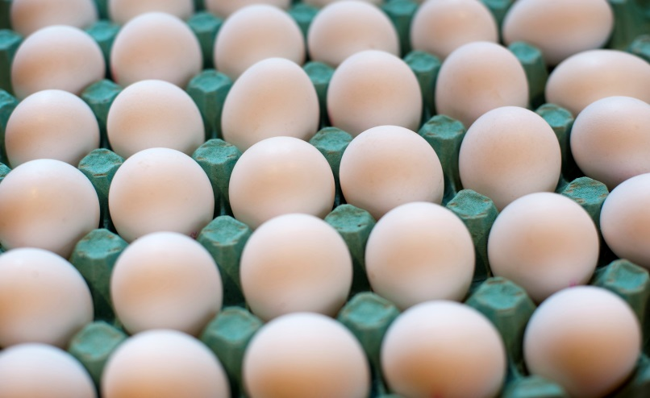


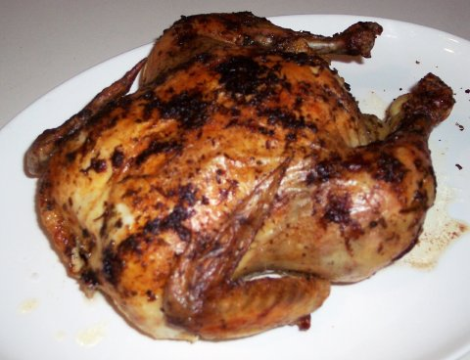
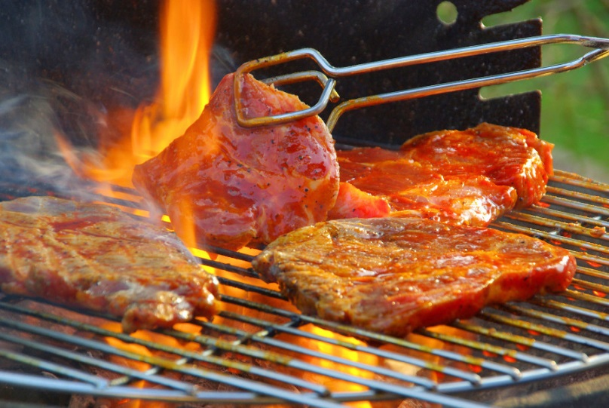
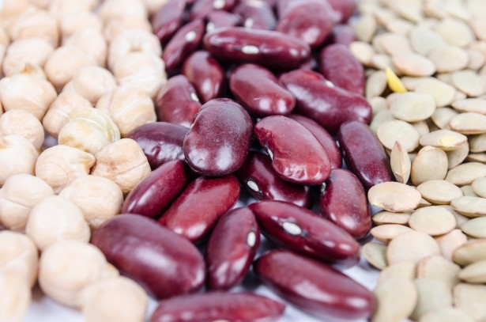
Protein
Notes:
Protein is in meat, poultry, fish, seafood, nuts, beans, tofu, soy, eggs, cheese.
These are the building blocks for muscle, hormones, genes, immune cells and brain cells.
The body can effectively use about 25-30 grams of protein at a time. So, protein shakes and supplement are not necessary for the majority of people. (see my article -How much protein do you need. Featured in the Jan 30th Torch)

Slide 9
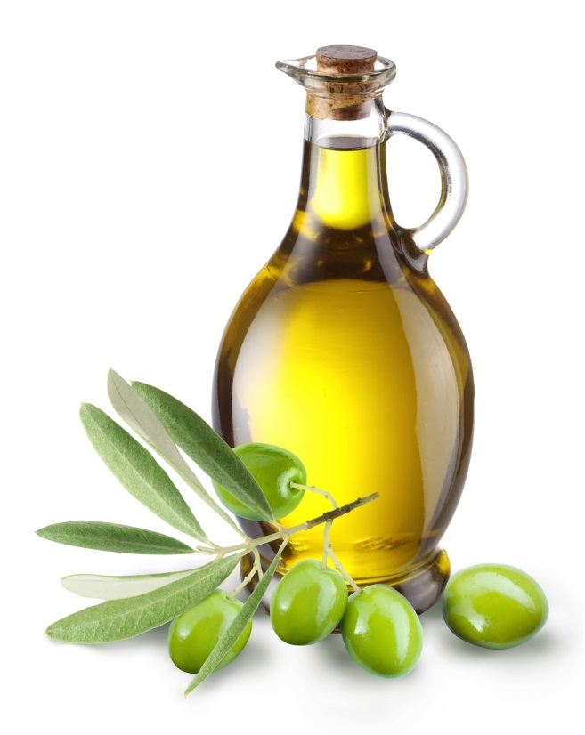
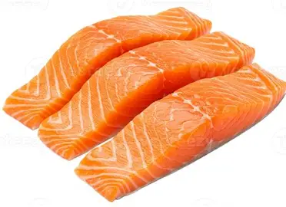
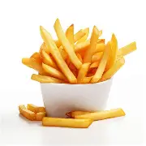
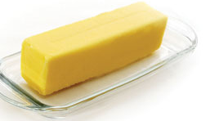
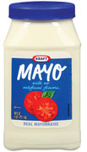
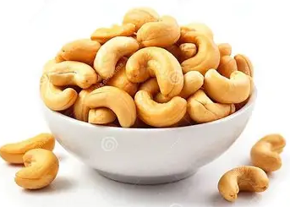
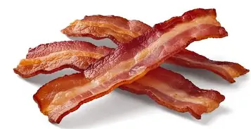
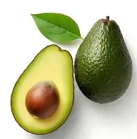

Fat
Notes:
Butter, milk, cheese, shortening, lard, the different oils, nuts, chocolate, avocados, fatty fish.
Fats also get a bad rap, but they are necessary for our digestive system to absorb certain vitamins and minerals. They insulate and protect vital organs. They store energy Fat are broken down and used for energy when . There are healthy and unhealthy fats. Try to avoid trans fat and limit saturated fat.

Slide 10

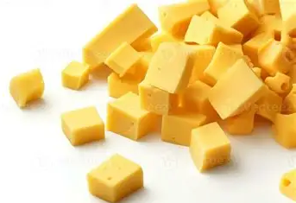
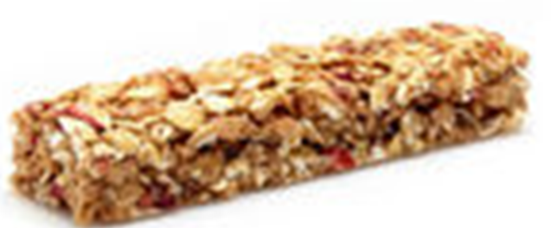
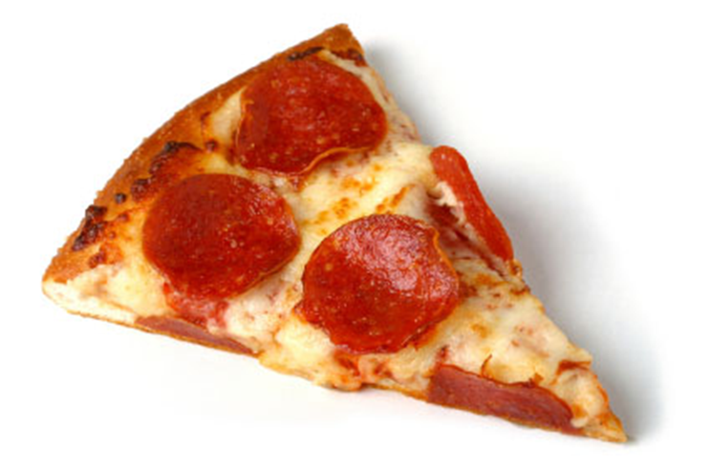
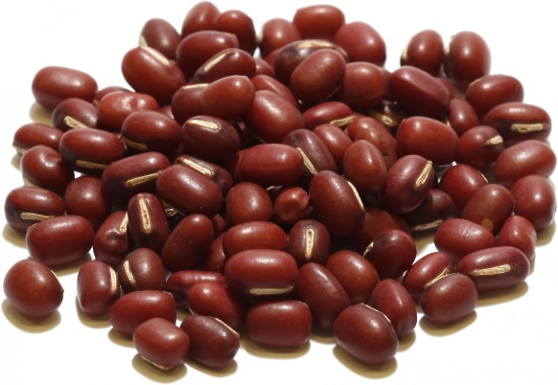
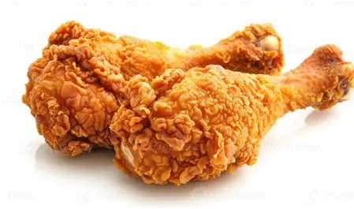
Food may contain
More than one nutrients
Notes:
For example, milk contains fat, protein, and carbs.

Slide 11
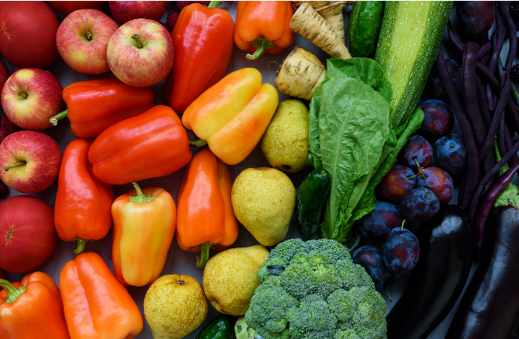
Eat
the Rainbow
Notes:
You may have been told to “Eat the Rainbow,” This refers to including colorful fruits and vegetables into your diet. Different colored fruits and vegetables provides necessary Vitamins, Minerals, Fiber, Antioxidants needed for optimal performance.

Slide 12
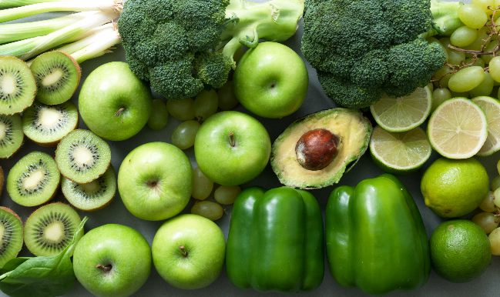
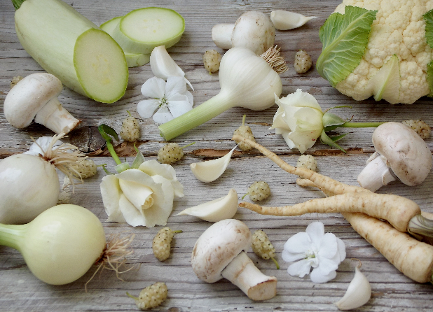
Green
White and Tan
Aid in Digestion
Support Heart Health
Support Eye Health
Support Brain Health
Cancer Protection
Decrease Heart Attack, Stroke, Heart Failure Atherosclerosis
Antioxidants
Supports Heart Health
Support Hormone Balance
Support the Immune System
Notes:
Green fruits and vegetables Apples, kiwi, peppers, broccoli, brussels sprouts, spinach, lettuce, and kale.
White and tan fruits and veggies - Bananas, jicama, fresh ginger, cauliflower and turnips.

Slide 13
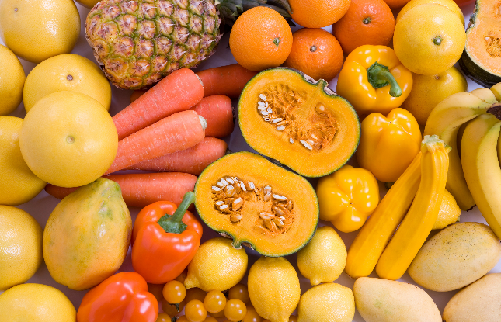
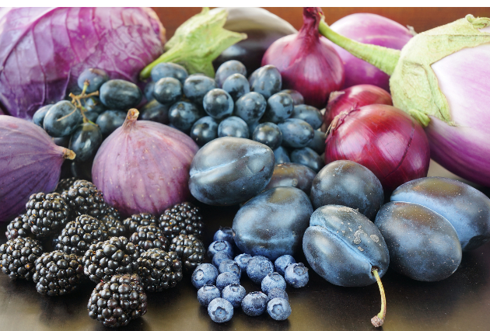
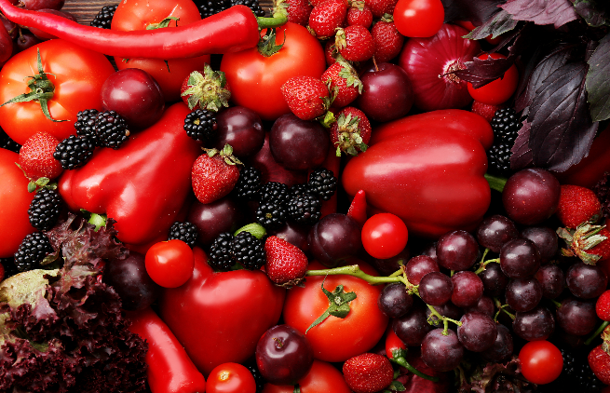
Orange & Yellow
Blue & Purple
Red
Supports Eye and Skin Health
Form and Build Strong teeth and Bones
Protects the Nervous System
Protects the Immune System to Resist Infection.
Supports Eye Health
Promotes Cancer Prevention
Supports Brain Health and Cognitive Function
Helps Prevent Cell Damage and Inflammation Linked With Chronic Disease
Supports Heart Health
Supports Cognitive Function
Lowers Risk of Certain Cancers
Protects Vision
Defends Cells From Damage That Causes Chronic Disease
Notes:
Orange and yellow fruits and vegetables : Mangos, carrots, yellow peppers, Papaya, pineapple, pears.
Contain anti-oxidants, Vitamin C, and Beta-Carotene which converts to vitamin A
Blue and Purple Fruits and Vegetables contain phytonutrients – plums, blueberries, eggplant, purple cabbage, elderberries and prunes
(((Inflammation is a normal function of the body and is necessary for life, but it may become an issue when it becomes ongoing, and a disease process is triggered. Ongoing inflammation may result in damage to the cells, tissues and organs.)))
Red Fruits and Vegetables - tomatoes, radishes, beets, peppers, red grapes, grapefruit, watermelon, and cherries.

Slide 14
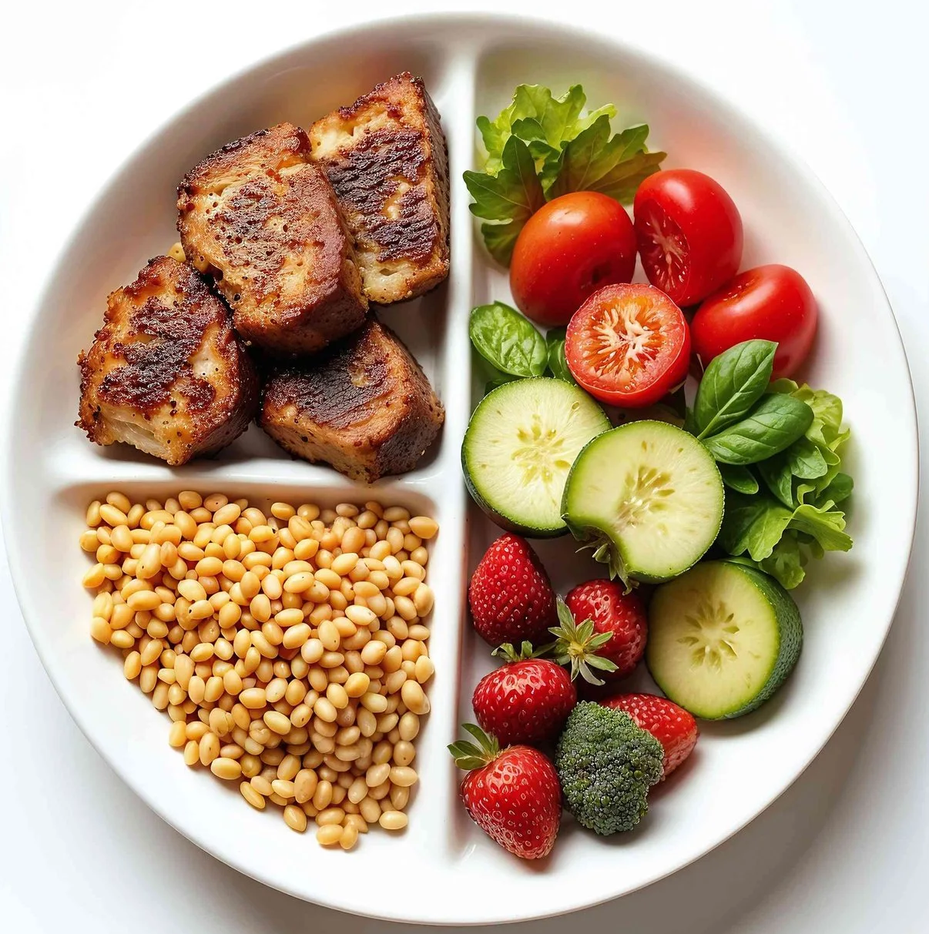
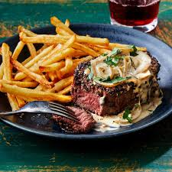
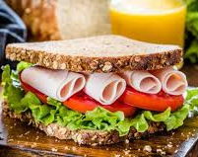
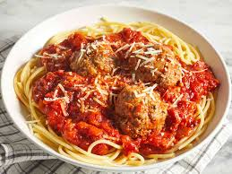

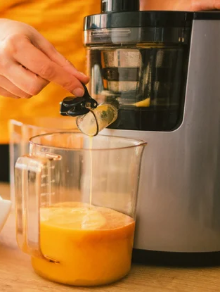
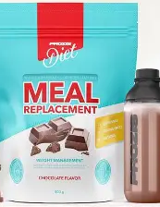
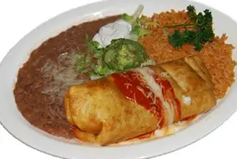
Making Informed Choices
Notes:
When aiming for healthy food choices, there are a few things to consider. Eating just a few types of foods and eliminating others, will not provide necessary nutrients.
This is true when eating the rainbow. Eating only apples out of the red, potatoes from the white, and peppers from the green group won’t cut it.
The ideal way to give your body what it needs is by eating real food. Pills and supplements can’t replace the real thing. Our bodies cannot digest and absorb nutrients as proficiently as it can from real food.
diet foods, drinks, pills, or fad diets that promise fast weight loss typically don’t contain the nutrients needed for a healthy diet and may harm the body.
Juicing is not healthy if is made only with fruit. It removes fiber but keeps the sugar. A rule of thumb - If you wouldn’t eat that much fruit in one sitting, you shouldn’t be drinking it.
Here - avoid foods you could not make at home. For example, corn chips or pop tarts. Fried foods and sugar may increase inflammation in the body as well.
Limit saturated fat, trans fat, sodium, sugar, and fast food, and highly processed food. If you cannot pronounce the ingredients, or you could not make at home, it’s probably not the right choice.

Slide 15




Notes:
For assistance with meal planning and other lifestyle choices, consider joining Real Appeal. UHC offers this program for free to the plan subscriber, covered spouses, and dependents 18 and older with a BMI or 23 or higher or certain health risks. With this criteria, most people will be eligible.

Slide 16
Education – Engagement –
Motivation – Support - Accountability
Learn lifestyle lessons
Small‑group interactive sessions led by a wellness coach
Personalized 1:1 coaching (for those who meet certain criteria)
Instructional and motivational videos
Track food, calories, exercise, weight, steps, and goals (Connects to many wearable devices)
Community chat
Notes:
Real Appeal is a weight management program that focuses on Education – Engagement – Motivation – Support and Accountability to encourage steady behavioral changes that improve health, prevent of chronic conditions, and provide lasting weight loss.
Scan the code, visit the website, or find it on your myuhc account.
For more information, watch my upcoming Real Appeal powerpoint presentation.

Slide 17
What’s YOUR Healthy? Healthy Eating
Eat whole grains, fruits, vegetables, lean protein, high fiber, healthy fats
Decrease sweets fried, and/or process foods
Decrease/ avoid sweet drinks and
Portion control
Find recipes to cook at home and have ingredients available
Eat slowly and mindfully
Notes:
It’s not to late to join the What’s your Healthy Wellness Challenge or to utilize the resources. Visit my google classroom to join.

Slide 18

Healthy Eating
Resources
​
Everyday Nutrition Dietary Guidelines Mindful Eating Health tips (Spanish) Eating Mediterranean Hunger-Satiety Scale Mindful Eating Exercises Healthy Eating Dash Eating plan | Everyday Nutrition brainshark presentation Mindful Eating DASH eating plan brainshark presentation Healthier Eating at Work MyPlate | U.S. Department of Agriculture Calm Health on Mindful Eating (UHC members can join Calm Health for $0. Log into your myuhc)
Notes:
There are many resources that can help with eating healthy. I am also a resource for you.

Slide 19
Checklist:
Variety:
Carbs, Proteins, and Fats from each food group, Eat the Rainbow
Nutrient rich:
Whole Grains, Lean Protein, Dairy, Starchy and Non-Starchy Vegetables, Whole Fruits
Limit:
Saturated and Trans Fat, Sugar, Processed, Fast food, Supplements
Explore:
Learn About Nutrition And Try New Foods
Notes:
Choosing food to improve your health can be a daunting task and may seem unattainable.
Remember, you are not aiming for perfection. You don’t need to remember and follow every detail of what we discussed.
Each and every healthy choice you make is beneficial.
Make a plan that works for you and modify it as needed. Typically, it’s best to start with a small goal. Maybe you want to eat a different color vegetable each day, 5 days a week. Or maybe you want to decrease foods with added sugar. Whatever you do, be proud of every success. Don’t give up or beat yourself up if you don’t succeed. Guilt is usually not a good motivator. Just keep trying. For information, please see the powerpoint and resources on goal planning
To wrap up, the most important things to remember are on this checklist.

Slide 20
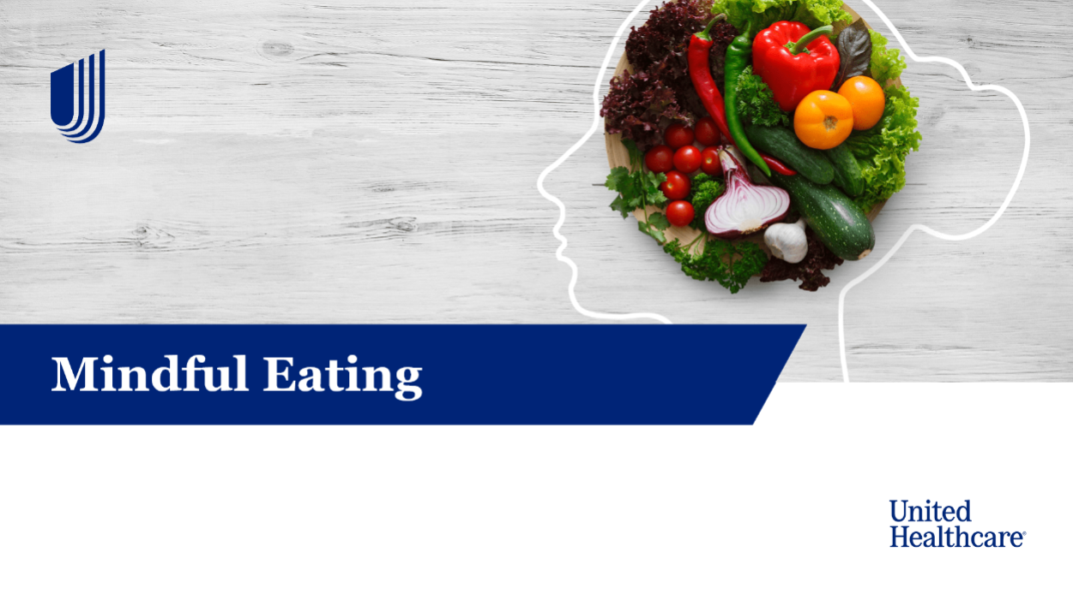
Please
complete this
short survey
https://forms.gle/fs96JPtVkpDhxZDC9
Thank You!
Michelle (Metallo) Fournier RN, CDCES
UnitedHealthcare Health Engagement Nurse
Kenosha Unified School District, ESC room 140
michelle_metallo@uhc.com 262-220-2671
my Google Classroom Wellness
Kenosha Unified School District site
Notes:
I hope you enjoyed this presentation of Choosing food for health. Please take a moment to provide feedback by completing a very short survey.
Once again, I am Michelle Fournier. Watch for my articles in the Torch, and for upcoming presentations Please visit my google classroom, and wellness site.
Remember, I am a resource for you.
Please reach out to me for questions or information on anything related to health, wellness, or UHC insurance benefits.
Thank you

